Slide 1


KNOWLEDGE INSTITUTE OF TECHNOLOGY Department of Electrical and Electronics Engineering
Smart Irrigation System Using IOT
Sivasankar C 611220105033
Dinesh Kumar P 611220105008
Jayaganth T 611220105015
TEAM MEMBERS
PROJECT SUPERVISOR
Dr.P.A.Gowrisankar,
Associate Professor
Department Of Electrical & Electronics Engineering
KIOT, Salem

Slide 2
INTRODUCTION
Monson dependent Indian Agriculture.
Automatic irrigation.
An over irrigation and under irrigation.
Soil moisture, air humidity, temperature and water level in the soil are wireless technology for batter production.

Slide 3
Objectives:
To save water and reduce human intervention in the agriculture field
To get the output of soil water Sensor and provide water to crop.

Slide 4
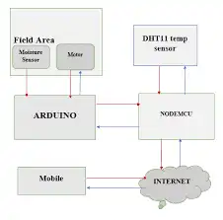
BLOCK DIAGRAM

Slide 5
WORKING
The block diagram of the proposed irrigation system is shown in Above. The main advantage of the proposed irrigation system is that it can send the information of a soil to the user through IOT network for irrigation.
Power supply is given to the circuit in the form of voltage or current. Here soil moisture sensor measures the water content of soil and its output is fed to the amplifier, which is used to improve the gain value.
And this measured value is given to the Arduino Uno as analog input These analog inputs are converted to digital output values by ESP8266.

Slide 6
SENSORS
Three sensor used in the system which are mainly as follows:
Temperature
Soil moisture
Humidity

Slide 7
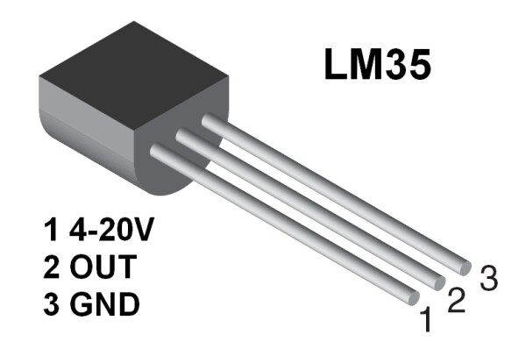
TEMPERATURE SENSOR
LM35
Output voltage is linearly proportional to the Celsius (centigrade) temperature.
Temperature range is -55to 150 degree C.

Slide 8
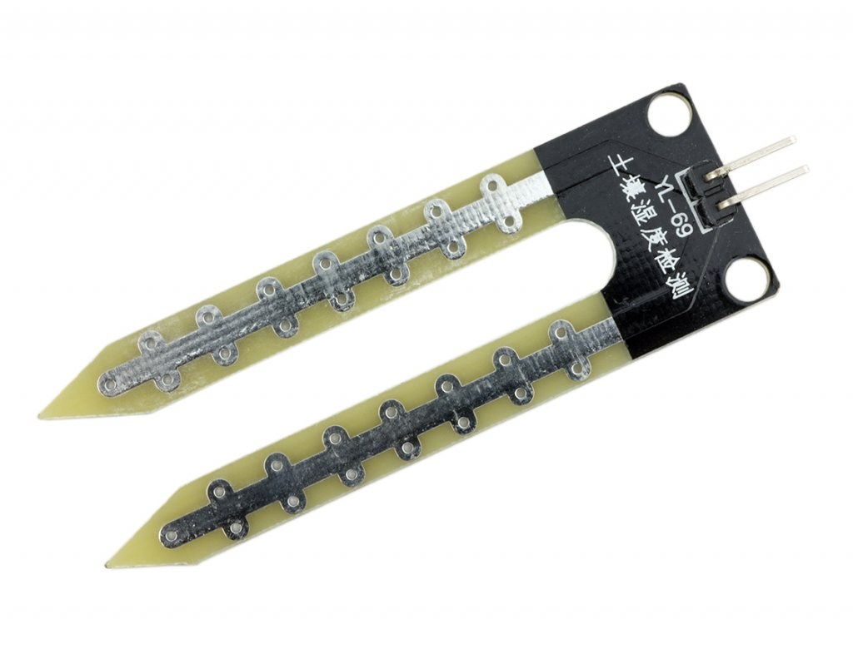
SOIL MOISTURE SENSORS
Common type is a frequency domain sensor .
Neutron moisture gauge.
In this sensor we are using 2 probes to be dipped into the soil as per moisture we will get analog output variations from 0.60-12 volts.

Slide 9
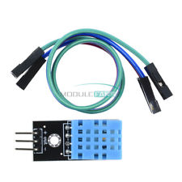
HUMIDITY SENSORS
It measures both air temperature and moisture .
Relative humidity expressed as a percentage .
HS1100 is used for sensing humidity .
The output in terms of frequency range 5khz to 10khz.

Slide 10
ADVANTAGES
Increase in productivity.
Reduced water consumption.
Safe.
No manpower required.
Reduce soil erosion and nutrient leaching.
Require smaller water source.

Slide 11
REFERENCES
Tope G., Patel A. 2014 . International Journal Of Current Engineering And Scientific Research (IJCESR). VOL.2.
www.ijert.org/ smart – irrigation –system –using –wireless-sensor-network
The ZigBee alliance website online available https://www.zigbee.org .

Slide 12
THANKYOU

